Slide 1
Types of Physics Involvement in Neural Networks
Sitikantha Roy
Physics-Guided, Physics-Informed, and Physics-Encoded Neural Networks in Scientific Computing

Slide 2
In what ways do you think one can incorporate physics into neural networks?
Data
Loss function
Architecture
Hybrid

Slide 3
Types
Physics-guided Neural Networks (PgNN)
Physics-informed Neural Networks (PiNN)
Physics-encoded Neural Networks (PeNN)

Slide 4
Physics-guided neural networks (PgNNs)
Supervised DL techniques to construct surrogate mappings between formatted inputs and outputs that are generated using experiments and computations
A PgNN-based model maps a set of inputs x to a related set of outputs y using an appropriate function F with unknown parameters w such that y = F(x;w)
Uses a data-driven approach to finetune parameters w such that error is minimized
Physics is encoded only in the form of data
F(x; w)
Inputs
Output
Notes:
Surrogate model – when any application of interest cannot be accessed immediately or is expensive, we model a surrogate to replicate the same application for immediate accessibility
Train networks to replace computationally expensive steps

Slide 5
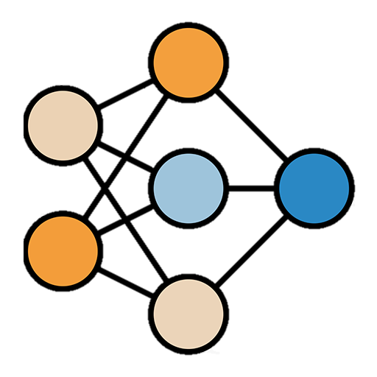
Physics-guided neural networks (PgNNs)
Supervised DL techniques to construct surrogate mappings between formatted inputs and outputs that are generated using experiments and computations
A PgNN-based model maps a set of inputs x to a related set of outputs y using an appropriate function F with unknown parameters w such that y = F(x;w)
Uses a data-driven approach to finetune parameters w such that error is minimized
Physics is encoded only in the form of data
Inputs
Output
Notes:
Surrogate model – when any application of interest cannot be accessed immediately or is expensive, we model a surrogate to replicate the same application for immediate accessibility
Train networks to replace computationally expensive steps

Slide 6
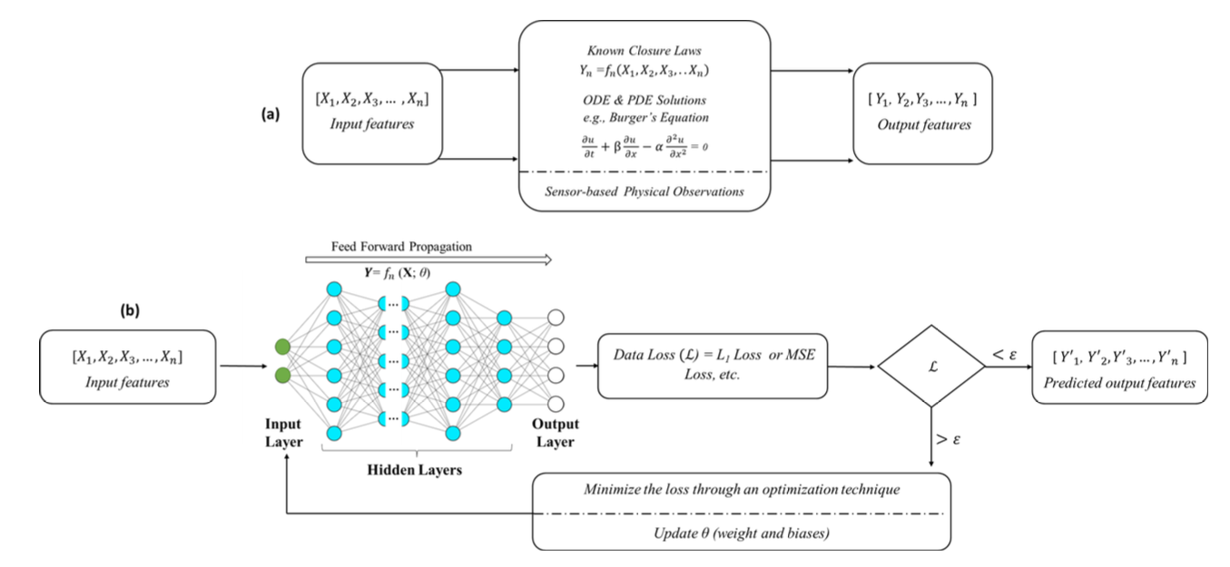
PgNNs
Data generation
Data-driven learning

Slide 7
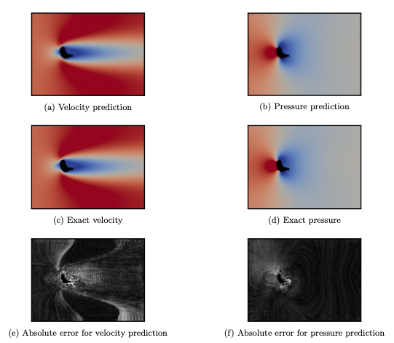
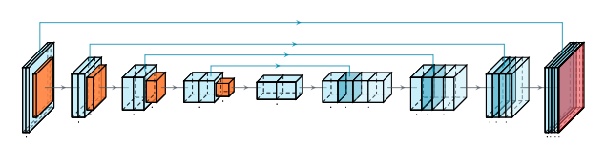
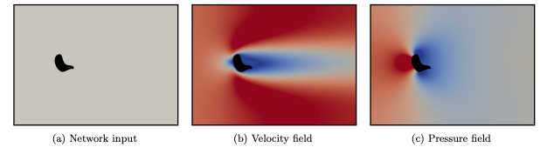
PgNNs - Applications
Extensively used to accelerate computationally expensive and time-consuming components of scientific computing
pre-processing
Modeling
post-processing
CNN-based model
Data generated using CFD solver for incompressible laminar flows
CNN based model predictions
Source: J. Chen, J. Viquerat, and E. Hachem. U-net architectures for fast prediction of incompressible laminar flows. arXiv preprint arXiv:1910.13532, 2019. DOI: https://doi.org/10.48550/arXiv.1910.13532.
Notes:
Pre-processing – mesh generation
Modelling – find solution
Post prosessing – output assimilation and visualization

Slide 8
PgNNs – Limitations
Model predictions are physics-agnostic
Can violate underlying physics because the generated model is based on statistical correlations.
Sparse training data
PgNN-based models fail in blind testing on conditions outside the scope of training
Predictions might be severely compromised
The lack of interpolation capabilities in complex and non-linear problems where the range of the physiochemical attributes is extremely wide (e.g., the range of Reynolds numbers from creeping flow to turbulent flow).
PgNNs may not fully satisfy the initial conditions and boundary conditions
New training data generation needed for new domain
Notes:
Agnostic – self learning model – no complete knowledge
Sparse – less

Slide 9
PgNNs – Limitations
Not resolution-invariant by construction
Cannot be trained on a lower resolution and be directly inferred on a higher resolution
Only designed to learn the solution of physical phenomena for a single instance (i.e., inputs-outputs)
Chance of overfitting
Since the training is pure data-driven, there is a high chance of model overfitting on training data
Struggle to learn diverse dataset
More data, complex model etc. are required which eventually increase the cost
Lack of generalization
model's ability to adapt properly to new, previously unseen data, drawn from the same distribution as the one used to create the model.
Notes:
Inariant – when works for any resolution
Resolution-invariant – Corse grid training data and fine grid testing
Generalization refers to your model's ability to adapt properly to new, previously unseen data, drawn from the same distribution as the one used to create the model.

Slide 10
Solution: PgNNs can be further constrained by governing physical laws, reducing the need for large datasets
Physics-informed neural networks (PiNNs)

Slide 11
Physics-informed neural networks (PiNNs)
Supervised learning tasks while obeying given laws of physics in the form of general non-linear differential equations
Incorporate physics laws by a loss function consisting of the residuals of physics equations and boundary constraints.
Automatic differentiation to differentiate the neural network outputs w.r.t their inputs (i.e., spatiotemporal coordinates and model parameters) which can be utilized in computing physics-driven loss function

Slide 12
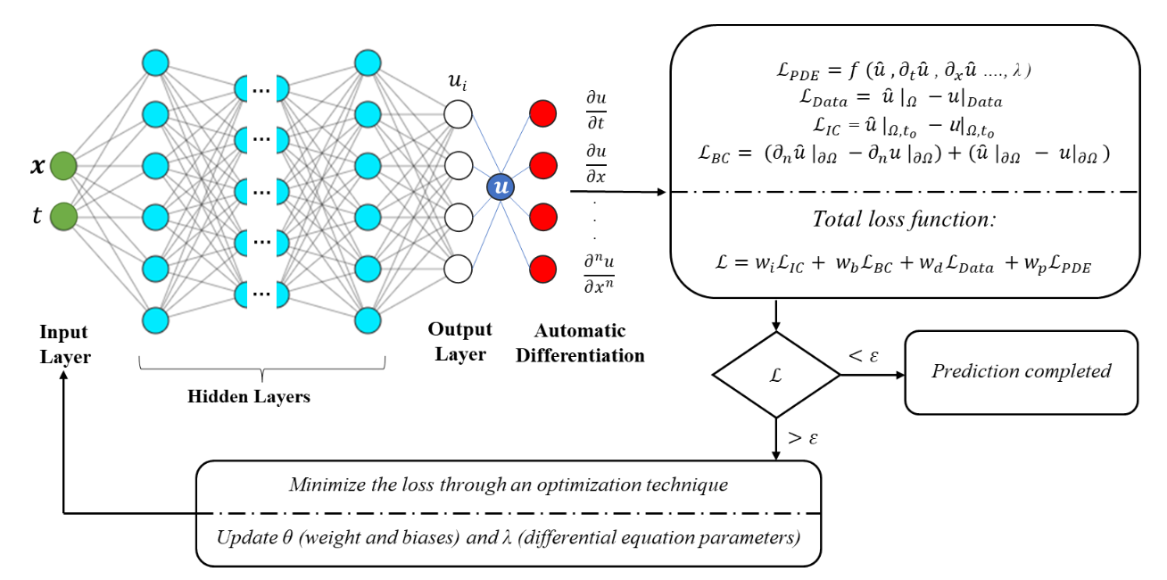
PiNNs
Vanilla PiNN architecture

Slide 13
PiNNs - Applications
Compared to PgNNs, the PiNN models provide more accurate predictions for forward and inverse modelling, particularly in scenarios with high non-linearities, limited data, or noisy data.
Used extensively in forward and inverse problems
PiNN can also be used to develop partial differential equations for unknown phenomena if training data representing the phenomenon’s underlying physics is available.

Slide 14
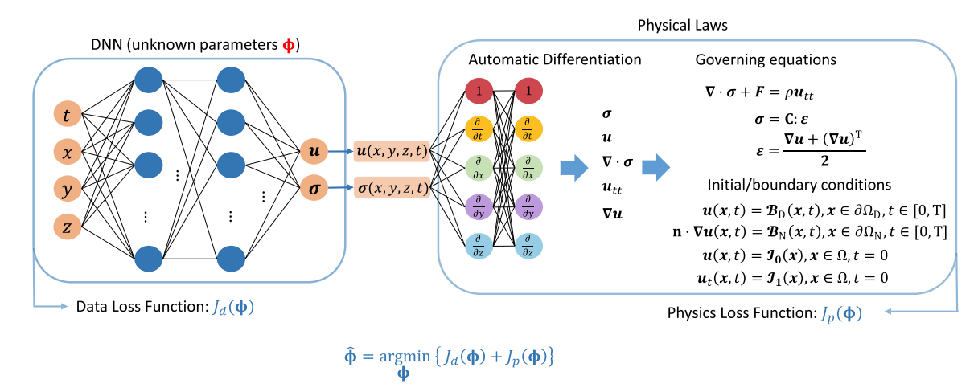
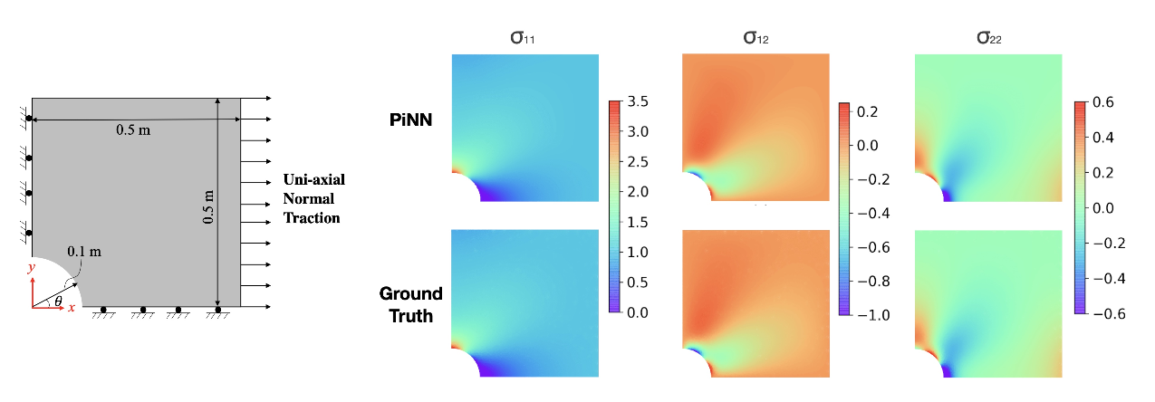
Forward
Problem
Static case t=0
A comparison between mixed-variable PiNN’s prediction and ground truth generated by FEM to predict the stress fields in a defected plate under uni-axial load
Notes:
Elastic problem
U – displacement vector
Sigma – stress tensor
Nabla operator

Slide 15
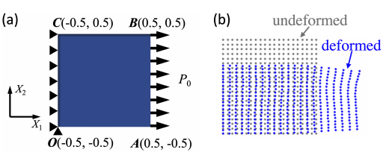
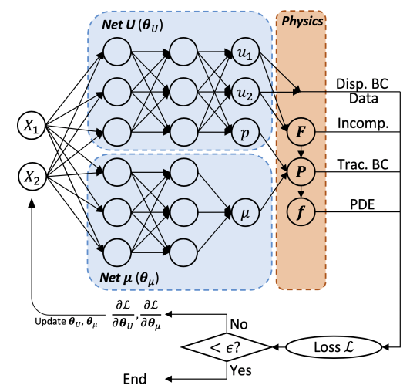
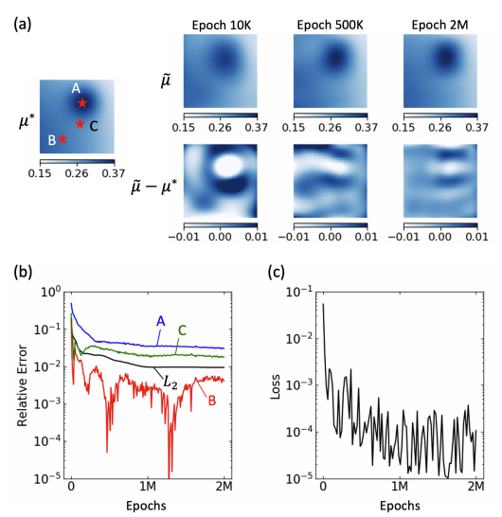
Inverse Problem
Ronneberger, O., Fischer, P. & Brox, T. U-net: Convolutional networks for biomedical image segmentation. In Med. Image. Comput. Comput. Assist. Interv.,234–241 (2015).
Notes:
Elastic static problem

Slide 16
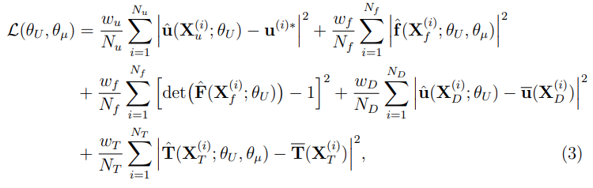
Loss for
inverse problem
Loss for
forward problem

Slide 17
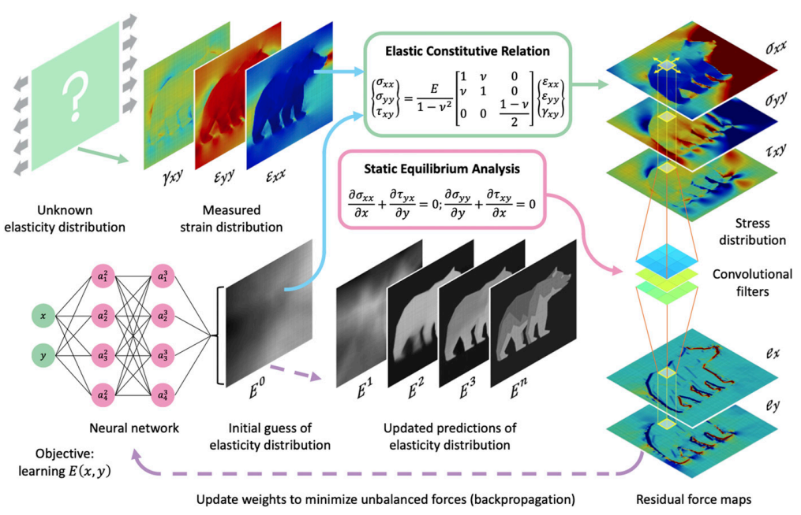
CNN + PiNN Formulation
Chen, C.T. and Gu, G.X., 2021. Learning hidden elasticity with deep neural networks. Proceedings of the National Academy of Sciences, 118(31), p.e2102721118.
Notes:
Elastrography
Using position and strain at material point, elasticity of the point is predicted

Slide 18
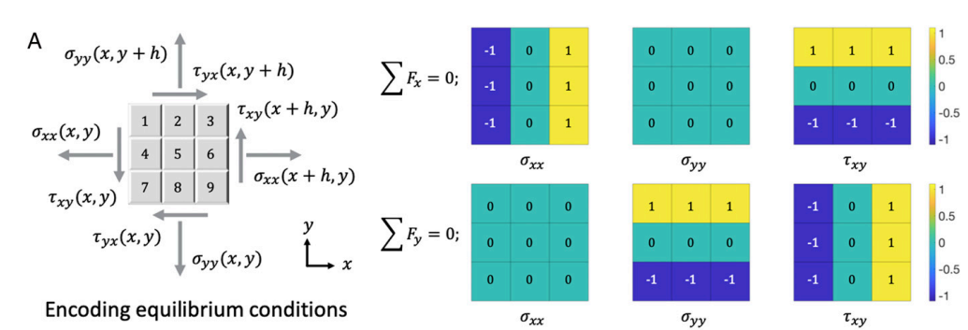
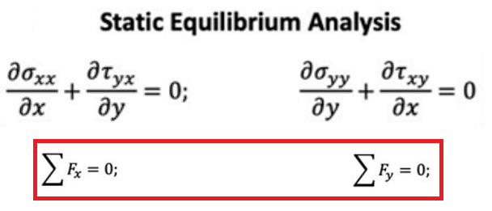
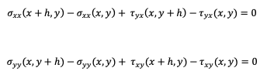

Slide 19

PiNNs - Limitations
Vanilla PiNN - face gradient vanishing problems and can be prohibitively slow for practical three-dimensional problems.
No ”solid” theoretical proof of convergence for PiNNs when applied to problems governed by non-linear PDEs.
Several terms in the loss function with relative weighting greatly affect the predicted solution. No guidelines for selecting weights optimally
Suffer generalization (new IC/BC conditions and PDE parameters)
PiNNs are solution learning algorithms, i.e., they learn the solutions to a given PDE for a single instance. For any given new instance of the functional parameters or coefficients, PiNNs require training a new neural network
Difficulties while learning the solutions to inverse problems in heterogeneous media
Change in parameters due to material change, but PiNN outputs same value

Slide 20
Several advanced PiNN architectures have been proposed to solve computations limitations however, generalization remains still a limitation
This led to new framework physics-encoded neural networks (PeNNs)

Slide 21
PeNN - Introduction
Hard-encode underlying physics (i.e., prior knowledge) into the core architecture of the neural networks
Instance learning (imposed by PgNN and PiNN architectures) to continuous learning
This encoding mechanism of physics is different from the penalty-based physics-informed learning, ensuring the network rigorously obeys the given physics.

Slide 22
PeNN
Two prominent approaches for encoding physics in neural network architectures:
Physics-encoded Recurrent Convolutional Neural Network (PeRCNN)
Neural Ordinary Differential Equations (NeuralODE)

Slide 23
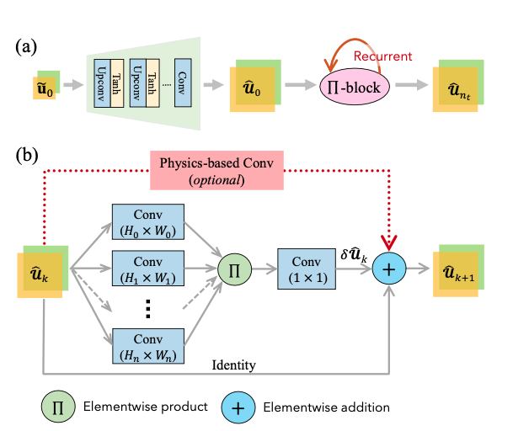
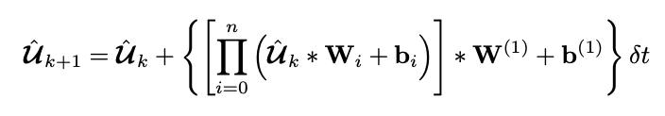

Physics-encoded recurrent-convolutional neural network (PeRCNN)
Noisy low resolution
Full resolution initial state ${\hat{U}}_{0}$
Predicted value at previous time step
residual of the dynamical system at time t_{k}, ${δ\hat{U}}_{k}$
δt - time spacing
∗ - Conv operation
W_{i}, b_{i} - weight and bias for the filter in the i^{th} layer
W⁽¹⁾, b⁽¹⁾ – params of 1 × 1 Conv filter
n + 1 - # parallel Conv layers
Physics-based Conv layer could be created when some specific terms are known a priori in the PDEs

Slide 24
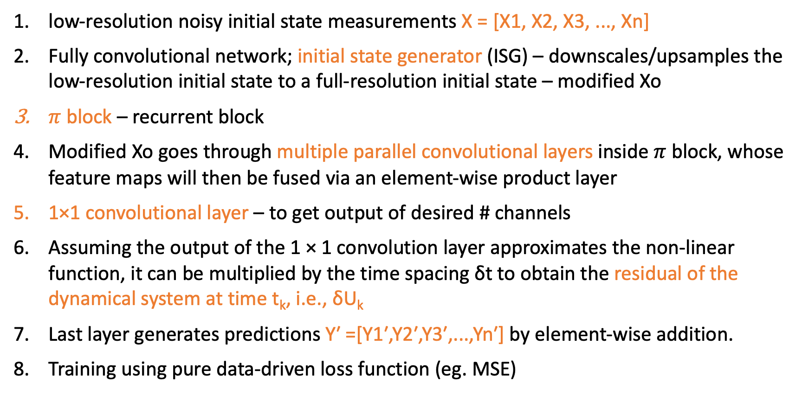
PeRCNN - Algorithm
low-resolution noisy initial state measurements X = [X1, X2, X3, ..., Xn]
Fully convolutional network; initial state generator (ISG) – downscales/upsamples the low-resolution initial state to a full-resolution initial state – modified Xo
$π$ block – recurrent block
Modified Xo goes through multiple parallel convolutional layers inside $π$ block, whose feature maps will then be fused via an element-wise product layer
1×1 convolutional layer – to get output of desired # channels
Assuming the output of the 1 × 1 convolution layer approximates the non-linear function, it can be multiplied by the time spacing δt to obtain the residual of the dynamical system at time t_{k}, i.e., δU_{k}
Last layer generates predictions Y′ =[Y1′,Y2′,Y3′,...,Yn′] by element-wise addition.
Training using pure data-driven loss function (eg. MSE)

Slide 25
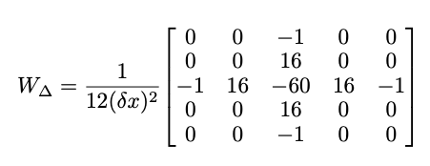
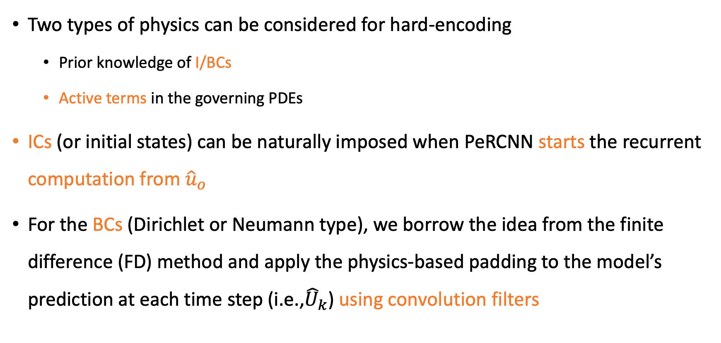
PeRCNN – Hard Encoding of Physics
Two types of physics can be considered for hard-encoding
Prior knowledge of I/BCs
Active terms in the governing PDEs
ICs (or initial states) can be naturally imposed when PeRCNN starts the recurrent computation from ${\hat{u}}_{o}$
For the BCs (Dirichlet or Neumann type), we borrow the idea from the finite difference (FD) method and apply the physics-based padding to the model’s prediction at each time step (i.e.,${\hat{U}}_{k}$) using convolution filters
HARD ENCODING OF PHYSICS FOR LEARNING SPATIOTEMPORAL DYNAMICS
FD Laplacian operator

Slide 26
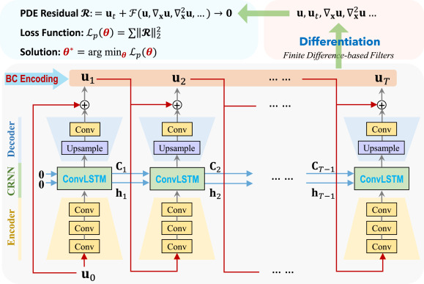
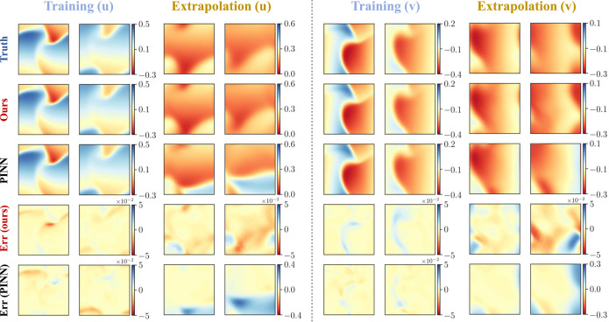
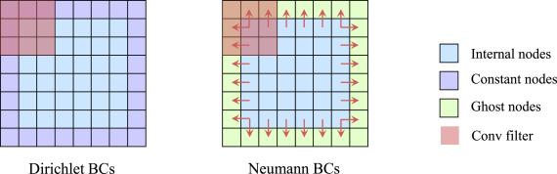
Results on 2D Burger’s equation
PeNN + PiNN Framework
Ren, P., Rao, C., Liu, Y., Wang, J. X., & Sun, H. (2022). PhyCRNet: Physics-informed convolutional-recurrent network for solving spatiotemporal PDEs. Computer Methods in Applied Mechanics and Engineering, 389, 114399.

Slide 27
PeRCNN – Alternative to Activation Functions
Elementwise product of the feature maps instead of using nonlinear activation functions, mainly for the reasons:
Poor interpretability - unfavourable to use these nonlinear functions to build a recurrent block that aims to generalize the unknown physics.
Nonlinear function F in the form of a polynomial covers a wide range of well-known dynamical systems, such as Navier-Stokes etc.
The spatial derivatives can be computed by Conv filters (Cai et al., 2012), a Π-block with n parallel Conv layers of appropriate filter size is able to represent a polynomial up to the nth-order
Π-block with 2 parallel layers of suitable filter size ensembles a family of polynomials up to 2nd order (e.g., u, ∆u, uv, u · ∇u)

Slide 28
PeNN – Pros and Cons
Pros:
Robust to data scarcity
More generalization compared to PgNN and PiNN
Transferable solutions
Cons:
PeNNs more difficult to train than PgNNs and PiNNs
Because of continuous-depth networks
PeNNs usually have complex architectures, and their implementation is not as straightforward as PiNNs or PgNNs
Most of the limitations faced by PgNN and PiNN (e.g., convergence rate, stability, scalability, sample size and problem dependency) are also faced by PeNN
Notes:
1. Data scarcity – hard encoding – no need for more data – easy learning
2. Transferable solutions – change from one domain to another with only few changes in architecture. No need for re-training

Slide 29
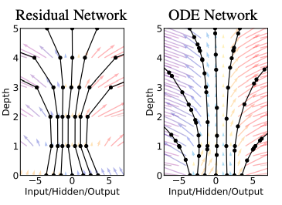


Neural Ordinary Differential Equations (NeuralODE)
Incorporation of physics in core architecture
In residual and recurrent networks, hidden state transformation can be given as:
t ∈ {0 . . . T} and h_{t} ∈ R^{D}
As we add more layers and take smaller steps, the above can be expressed as ODE (Euler’s method):
Starting from the input layer h(0), we can define the output layer h(T) to be the solution to this ODE initial value problem at some time T

Slide 30
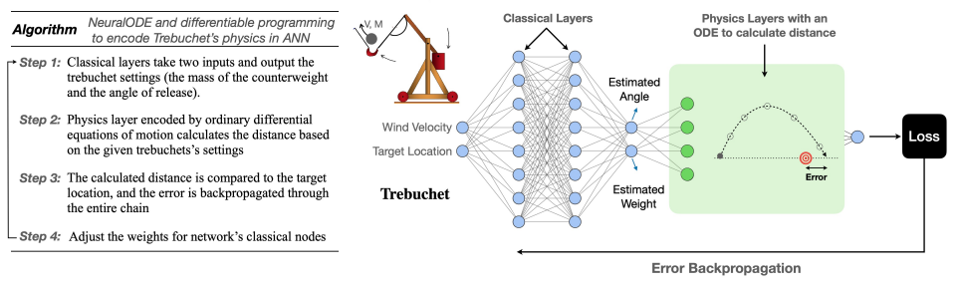
Neural Ordinary Differential Equations (NeuralODE)
Inverse problem of Trebuchet
M. Innes, A. Edelman, K. Fischer, C. Rackauckas, E. Saba, V.B. Shah, and W. Tebbutt. A differentiable programming system to bridge machine learning and scientific computing. arXiv preprint arXiv:1907.07587, 2019. DOI: https://doi.org/10.48550/arXiv.1907.07587.

Slide 31
NeuralODE Pros and Cons
Memory efficiency
Gradient computation in ODE solver is done without backpropagating through the operations of the solver
This reduces storing memory of intermediate quantities
Parameter efficiency
Requires less number of parameters than the competitors
Continuous time-series models
can naturally incorporate data which arrives at arbitrary times unlike discrete models which accept data at fixed points
Major drawback: Difficulty in backpropagation – not as straightforward as Automatic Differentiation

Slide 32
PgNNs, PiNNs, and PeNNs, are generally designed to map the solution of a physical phenomenon. Thus, must be re-trained or modified to map the solution under a different instant.
Neural operators

Slide 33
Neural Operators (NOs)
New research area
Supervised learning methods that learn the underlying linear and nonlinear continuous operators, such as integrals and fractional Laplacians, using advanced architectures
A neural operator can be combined with PiNN and PeNN methods to train a model that can learn complex non-linearity in physical systems with extremely high generalization accuracy
Robust for applications requiring real-time inference

Slide 34


